Slide 1
Dog Care Merit Badge
Troop 344/9344
Pemberville, OH

Slide 2
Dog Care Merit Badge Requirements
Do the following:
Briefly discuss the historical origin and domestication of the dog.
Describe some common characteristics of the dogs that make up each of the seven major dog groups.
Tell some specific characteristics of seven breeds of dogs (one from each major group), OR give a short history of one breed.
Point out on a dog or a sketch at least 10 body parts. Give the correct name of each one.
Do the following:
Explain the importance of house-training, obedience training, and socialization training for your dog.
Explain what "responsible pet ownership" means.
Explain what issues (including temperament) must be considered when deciding on what breed of dog to get as a family pet.

Slide 3
Dog Care Merit Badge Requirements
For two months, keep and care for your dog.* Maintain a log of your activities during this period that includes these items: feeding schedule, types of food used, amount fed, exercise periods, training schedule, a weekly body weight record, grooming and bathing schedules, veterinary care, if necessary, and costs. Also include a brief description of the type of housing/shelter arrangements you have for your dog.
Explain the correct way to obedience train a dog and what equipment you would need. Show with your dog any three of these commands: "come", "sit", "down", "heel", "stay", "fetch" or "get it", and "drop it".

Slide 4
Dog Care Merit Badge Requirements
Do the following:
Discuss the proper vaccination schedule for a dog in your area from puppyhood through adulthood.
Discuss the control methods for preventing fleas, ticks, heartworms, and intestinal parasites (worms) for a dog in your area from puppyhood through adulthood.
Explain the importance of dental care and tooth brushing to your pet's health.
Discuss the benefits of grooming your dog's coat and nails on a regular basis.
Discuss with your counselor any seasonal conditions (like hot summers, cold winters, or extreme humidity) where you live that need to be considered for your dog.
Discuss with your counselor the considerations and advantages of spaying or neutering your dog.

Slide 5
Dog Care Merit Badge Requirements
Do the following:
Explain the precautions to take in handling a hurt dog.
Show how to put on an emergency muzzle.
Explain how to treat wounds. Explain first aid for a dog bite.
Show how to put on a simple dressing and bandage the foot, body, or head of your dog.
Explain what to do if a dog is hit by a car.
List the things needed in every dog owner's first-aid kit.
Tell the dangers of home treatment of a serious ailment.
Briefly discuss the cause and method of spread, the signs and symptoms and the methods of prevention of rabies, parvovirus, distemper, and heartworms in dogs.

Slide 6
Dog Care Merit Badge Requirements
Visit a veterinary hospital or an animal shelter and give a report about your visit to your counselor.
Know the laws and ordinances involving dogs that are in force in your community.
Learn about three career opportunities for working with dogs. Pick one and find out about the education, training, and experience required for this career, and discuss this with your counselor. Tell why this profession interests you.

Slide 7
Requirement 1
Do the following:
Briefly discuss the historical origin and domestication of the dog.
Describe some common characteristics of the dogs that make up each of the seven major dog groups.
Tell some specific characteristics of seven breeds of dogs (one from each major group), OR give a short history of one breed.

Slide 8
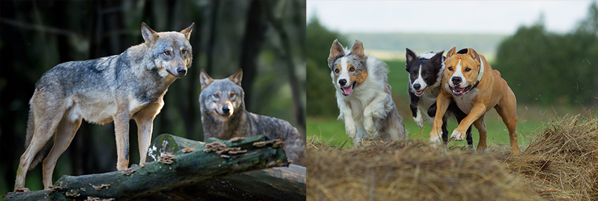
Historical Origin and Domestication of the Dog
For more than 12,000 years the dog has lived with humans as a hunting companion, protector, and friend.
The dog evolved from the gray wolf into more than 400 distinct breeds.
Human beings have played a major role in creating dogs that fulfill distinct societal needs.
Although details about the evolution of dogs are uncertain, the first dogs were hunters with keen senses of sight and smell.
Humans developed these instincts and created new breeds as need or desire arose.
Dogs have played an important role in the history of human civilization and were among the first domesticated animals.
They were important in hunter-gatherer societies as hunting allies and bodyguards against predators.
When livestock were domesticated about 7,000 to 9,000 years ago, dogs served as herders and guardians of sheep, goats, and cattle.

Slide 9
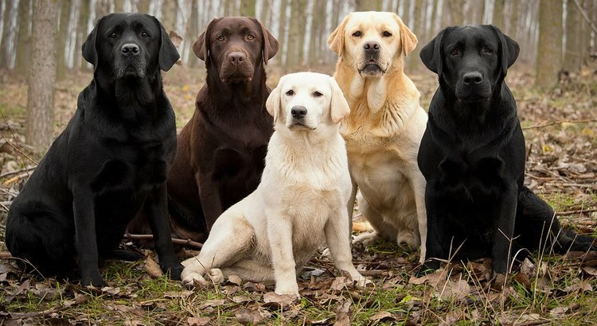
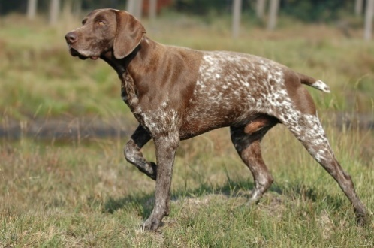
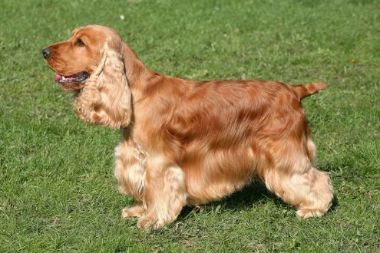
Seven Major Dog Groups
Sporting Group
Breeds in the Sporting Group were bred to assist hunters in the capture and retrieval of feathered game. Retrievers, built for swimming, specialize on waterfowl, while the hunting grounds of setters, spaniels, and pointing breeds are grasslands where quail, pheasant, and other game birds nest. Many Sporting Group breeds possess thick, water-repellant coats resistant to harsh hunting conditions.
Breeds You May Know:
Labrador Retriever
German Shorthaired Pointer
Cocker Spaniel

Slide 10
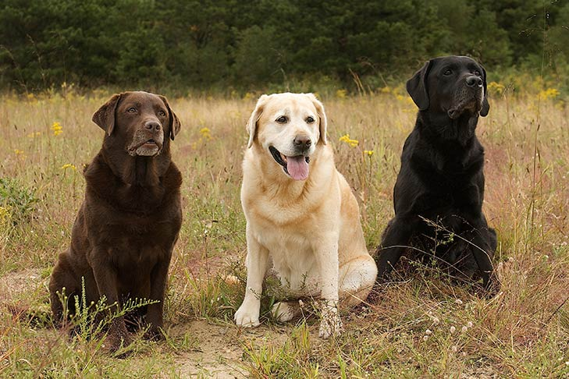
Labrador Retriever
Height: 22.5-24.5 inches (male), 21.5-23.5 inches (female)
Weight: 65-80 pounds (male), 55-70 pounds (female)
Life Expectancy: 10-12 years
The dense, hard coat comes in yellow, black, and chocolate..
Labs are famously friendly. They are companionable housemates who bond with the whole family, and they socialize well with neighbor dogs and humans alike.
The Lab is an enthusiastic athlete that requires lots of exercise, like swimming and marathon games of fetch, to keep physically and mentally fit.

Slide 11
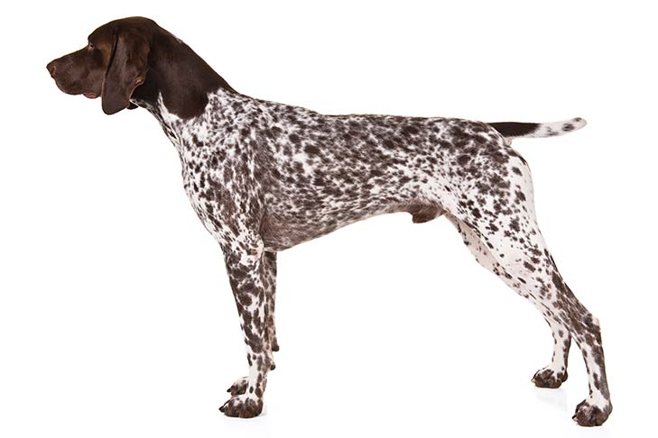
German Shorthaired Pointer
Height: 23-25 inches (male), 21-23 inches (female)
Weight: 55-70 pounds (male), 45-60 pounds (female)
Life Expectancy: 10-12 years
The coat is solid liver (a reddish brown), or liver and white in distinctive patterns.
Built to work long days in the field or at the lake, they are known for power, speed, agility, and endurance.
GSPs make happy, trainable pets who bond firmly to their family.
They are always up for physical activities like running, swimming, or anything that will burn some of their boundless energy while spending outdoors time with a human buddy.

Slide 12
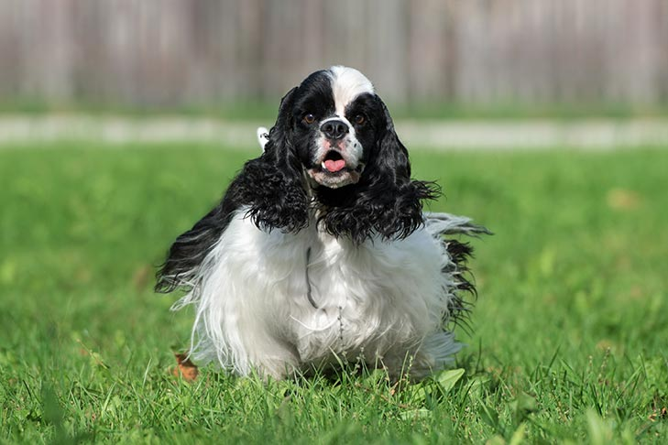
Cocker Spaniel
Height: 14.5-15.5 inches (male), 13.5-14.5 inches (female)
Weight: 25-30 pounds (male), 20-25 pounds (female)
Life Expectancy: 10-14 years
They have big, dark eyes and long, lush ears. The coat comes in enough colors and patterns to please any taste. The well-balanced body is sturdy and solid, and these quick, durable gundogs move with a smooth, easy gait.
Cockers are eager playmates for kids and are easily trained as companions and athletes. They are big enough to be sporty, but compact enough to be portable. These energetic sporting dogs love playtime and brisk walks.

Slide 13
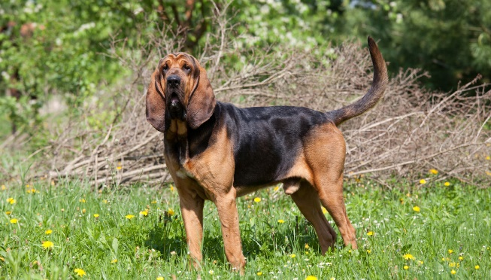
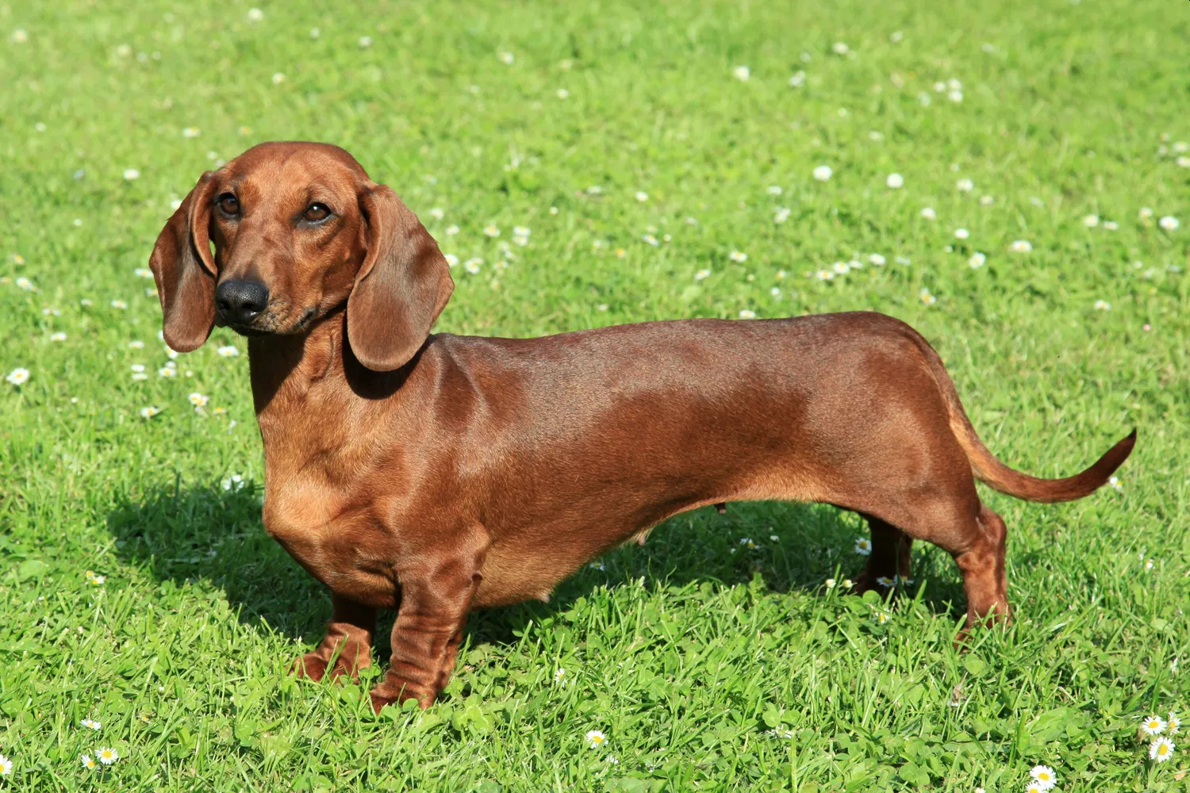
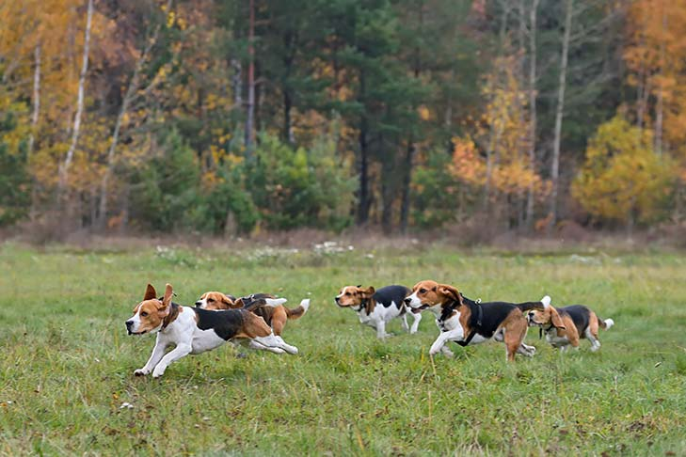
Seven Major Dog Groups
Hound Group
All breeds in the Hound Group were bred to pursue warm-blooded quarry. The sleek, long-legged sighthounds use explosive speed and wide vision to chase swift prey, like jackrabbits and antelope, while tough, durable scent hounds rely on their powerful noses to trail anything from raccoons to escaped convicts. Members of the Hound Group possess strong prey drives and often will stop at nothing to catch their quarries.
Breeds You May Know:
Bloodhound
Dachshund
Beagle

Slide 14
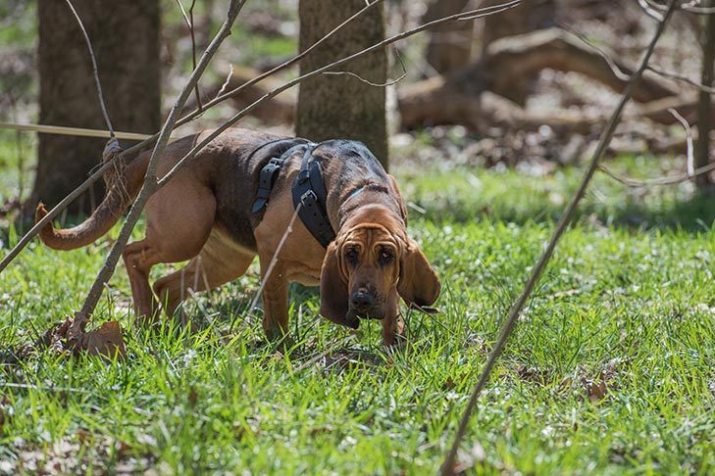
Bloodhound
Height: 25-27 inches (male), 23-25 inches (female)
Weight: 90-110 pounds (male), 80-100 pounds (female)
Life Expectancy: 10-12 years
Their most famous features are a long, wrinkled face with loose skin; huge, drooping ears; and warm, deep-set eyes. Coat colors can be black and tan, liver and tan, or red. Powerful legs allow Bloodhounds to chase scent over miles of punishing terrain.
As pack dogs, Bloodhounds enjoy company, including other dogs and kids. They are easygoing, but their nose can sometimes lead them into trouble. Bloodhounds are droolers, and obedience training them can be a challenge.

Slide 15
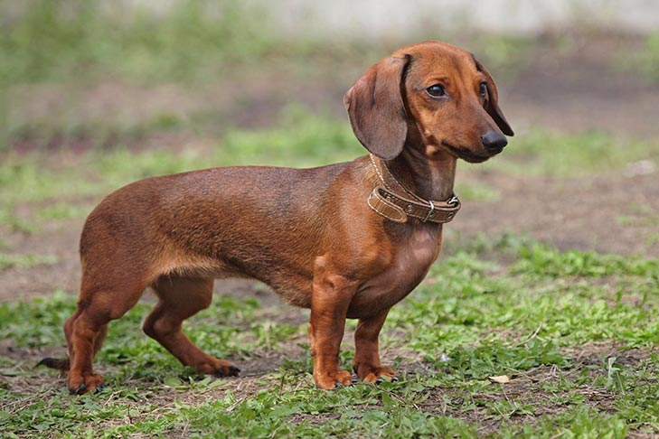
Dachshund
Height: 8-9 inches (standard), 5-6 inches (miniature)
Weight: 16-32 pounds (standard), 11 pounds & under (miniature)
Life Expectancy: 12-16 years
The Dachshund has the unmistakable long-backed body, little legs, and big personality. Dachshunds come in one of three coat types: smooth, wirehaired, or longhaired.
Dachshunds aren’t built for distance running, leaping, or strenuous swimming, but otherwise these tireless hounds are game for anything. Smart and vigilant, with a big-dog bark, they make fine watchdogs. Bred to be an independent hunter of dangerous prey, they can be brave to the point of rashness, and a bit stubborn.

Slide 16
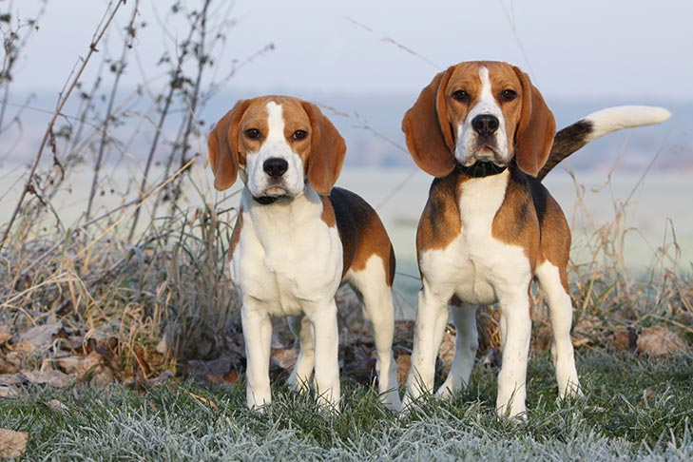
Beagle
Height: 13 inches & under, 13-15 inches
Weight: under 20 pounds (13 inches & under), 20-30 pounds (13-15 inches)
Life Expectancy: 10-15 years
They come in such pleasing colors as lemon, red and white, and tricolor. The Beagle’s fortune is in his adorable face, with its big brown or hazel eyes set off by long, houndy ears set low on a broad head. Beagles are loving and lovable, happy, and companionable—all qualities that make them excellent family dogs. The Beagle has been one of the most popular dogs among American pet owners. They are curious, clever, and energetic hounds who require plenty of playtime.

Slide 17
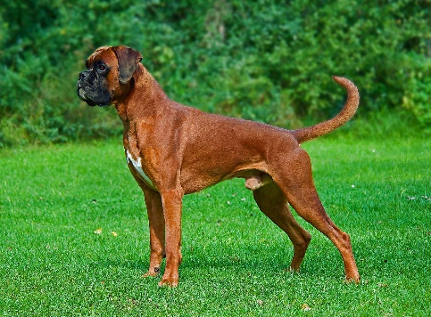
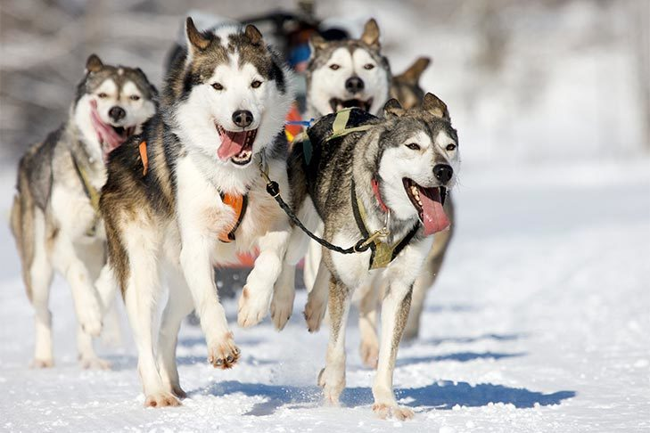
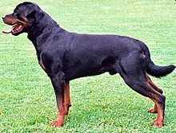
Seven Major Dog Groups
Working Group
Breeds in the Working Group are dogkind’s punch-the-clock, blue-collar workers, and the group includes some of the world’s most ancient breeds. They were developed to assist humans in some capacity – including pulling sleds and carts, guarding flocks and homes, and protecting their families – and many of these breeds are still used as working dogs today. Breeds in the Working Group tend to be known for imposing stature, strength, and intelligence.
Breeds You May Know:
Boxer
Siberian Husky
Rottweiler

Slide 18
Boxer
Height: 23-25 inches (male), 21.5-23.5 inches (female)
Weight: 65-80 pounds (male), females are about 15 pounds less than male
Life Expectancy: 10-12 years
Their muscles ripple beneath a short, tight-fitting coat. The dark brown eyes and wrinkled forehead give the face an alert, curious look. The coat can be fawn or brindle, with white markings. Boxers move like the athletes they are named for: smooth and graceful, with a powerful forward thrust.
Boxers are upbeat and playful. Their patience and protective nature have earned them a reputation as a great dog with children. They take the jobs of watchdog and family guardian seriously and will meet threats fearlessly. Boxers do best when exposed to a lot of people and other animals in early puppyhood.

Slide 19
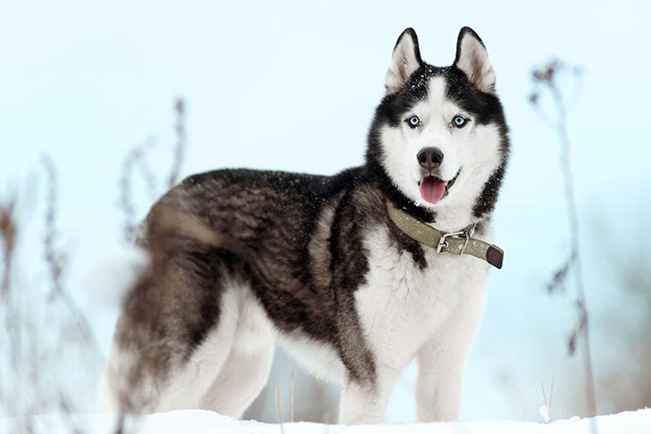
Siberian Husky
Height: 21-23.5 inches (male), 20-22 inches (female)
Weight: 45-60 pounds (male), 35-50 pounds (female)
Life Expectancy: 12-14 years
The graceful Siberian Husky’s almond-shaped eyes can be either brown or blue and sometimes one of each.
Quick and nimble-footed, Siberians are known for their powerful but seemingly effortless gait.
As born pack dogs, Siberians enjoy family life and get on well with other dogs; their innate friendliness render them indifferent watchdogs.
This breed is also energetic and can’t resist chasing small animals, so secure running room is a must.
Siberians are naturally clean, with little doggy odor.

Slide 20
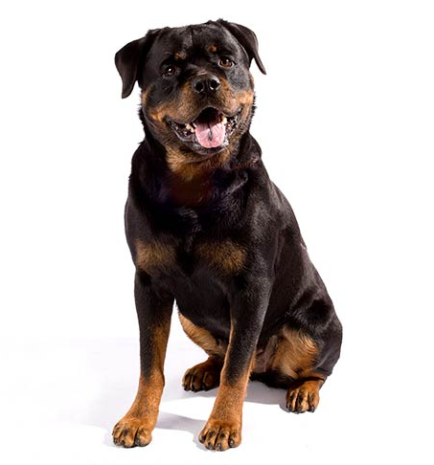
Rottweiler
Height: 24-27 inches (male), 22-25 inches (female)
Weight: 95-135 pounds (male), 80-100 pounds (female)
Life Expectancy: 9-10 years
Rottweilers have glistening, short black coat with rust markings.
A thickly muscled hindquarters powers the Rottie’s effortless trotting gait.
A well-bred and properly raised Rottie will be calm and confident, courageous but not unduly aggressive. The aloof demeanor these world-class guardians present to outsiders belies the playfulness, and downright silliness, that endear Rotties to their loved ones. Early training and socialization will harness a Rottie’s territorial instincts in a positive way.

Slide 21
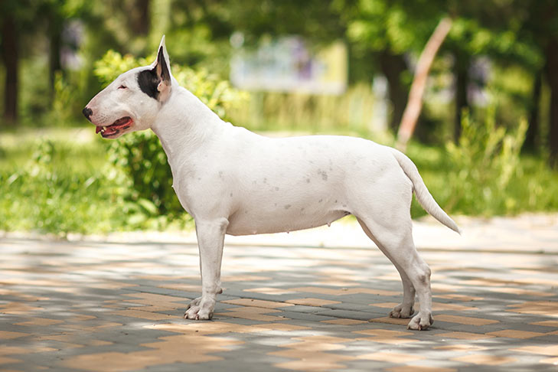
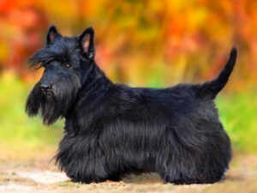
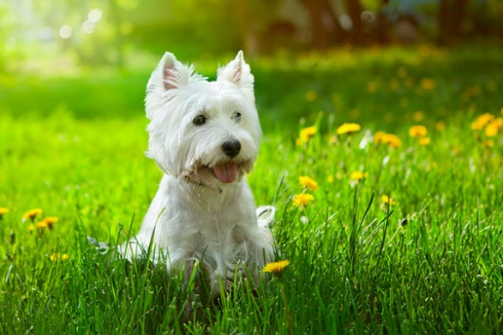
Seven Major Dog Groups
Terrier Group
The feisty, short-legged breeds in the Terrier Group were first bred to go underground in pursuit of rodents and other vermin. Long-legged terrier breeds dig out varmints rather than burrowing in after them, while the group’s “bully” breeds, created long ago for ghastly pursuits like bull-baiting, are popular companion dogs today. Breeds You May Know:
Bull Terrier
Scottish Terrier
West Highland White Terrier

Slide 22
Bull Terrier
Height: 21-22 inches
Weight: 50-70 pounds
Life Expectancy: 12-13 years
Bull Terriers are robust, big-boned terriers who move with a jaunty stride suggesting agility and power.
The breed’s hallmark is a long, egg-shaped head with erect and pointed ears, and small, triangular eyes.
Coats come in two types: white; and any other color (including an attractive brindle striping), either solid or with white markings.
There are four keys to this breed’s happiness: early socialization with dogs and people; firm but loving training; ample exercise; and lots of quality time with his adored humans.

Slide 23
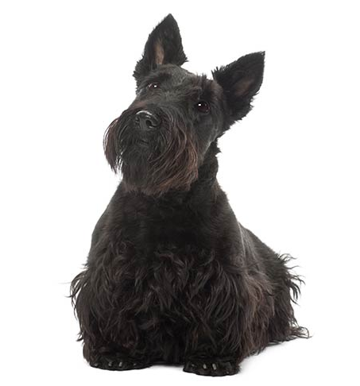
Scottish Terrier
Height: 10 inches
Weight: 19-22 pounds (male), 18-21 pounds (female)
Life Expectancy: 12 years
The well-known Scottie silhouette is that of a short-legged but substantial terrier with distinctive furnishings at the beard, legs, and lower body.
The wiry topcoat and soft, dense undercoat coat can be black, wheaten yellow, or a brindle-stripe pattern.
Bright, piercing eyes, and erect ears and tail, convey keen alertness—a hallmark of Britain’s terrier breeds.
Their aloofness toward strangers makes them excellent watchdogs.
Their hunting instinct remains strong, which can complicate life for the neighbor’s cat, and Scotties are known to be cantankerous around other dogs. This dog enjoys brisk walks and upbeat play.

Slide 24
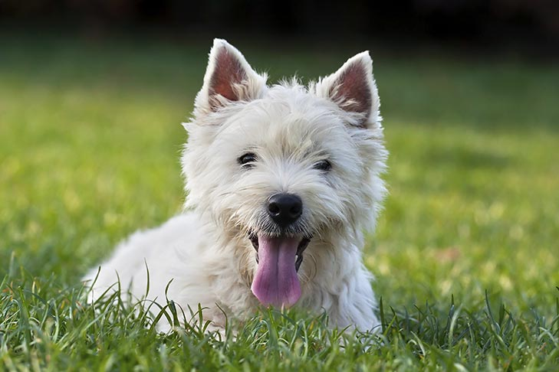
West Highland White Terrier
Height: 11 inches (male). 10 inches, female
Weight: 15-20 pounds
Life Expectancy: 13-15 years
Westie’s have dark piercing eyes, compact body, and a carrot-shaped tail.
The all-white double coat is hard to the touch, not soft and fluffy.
Beneath the plush-toy exterior, though, is a true working terrier of gameness and courage. Bred to hunt rats and other underground rodents, Westies are surprisingly strong and tough.
They require no pampering, they will chase after anything that moves, and their independence can make training a challenge. But, thanks to their faithfulness and keen intelligence, Westies will train nicely with time and patience.

Slide 25
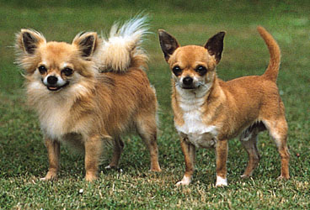
Seven Major Dog Groups
Toy Group
The diminutive breeds of the Toy Group come in enough coat types and colors to satisfy nearly any preference, but all are small enough to fit comfortably in the lap of their adored humans. In a way, toys dogs are their own version of working dogs: they work hard at being attentive, affectionate companions. Breeds in the Toy Group are popular with city dwellers, as their small size makes them a good fit for smaller yards or apartments.
Breeds You May Know:
Chihuahua
Pug
Shih Tzu

Slide 26
Chihuahua
Height: 5-8 inches
Weight: not exceeding 6 pounds
Life Expectancy: 14-16 years
The Chihuahua is a balanced, graceful dog of terrier-like demeanor.
The rounded “apple” head is a breed hallmark. The erect ears and full, luminous eyes are acutely expressive.
Coats come in many colors and patterns, and can be long or short. The varieties are identical except for coat.
Chihuahuas possess loyalty, charm, and big-dog attitude. Even tiny dogs require training, and without it they will rule your household like a little Napoleon. Compact and confident, Chihuahuas are ideal city pets. They are too small for roughhousing with kids, and special care must be taken in cold weather.

Slide 27
Pug
Height: 10-13 inches
Weight: 14-18 pounds
Life Expectancy: 13-15 years
Small but muscular breed. They come in three colors: silver or apricot-fawn with a black face mask, or all black. The large round head, the big, sparkling eyes, and the wrinkled brow give Pugs a range of human-like expressions—surprise, happiness, curiosity—that have delighted owners for centuries.
Pug owners say their breed is the ideal house dog. Pugs are happy in the city or country, with kids or old folks, as an only pet or in a pack. They enjoy their food, and care must be taken to keep them trim. They do best in moderate climates—not too hot, not too cold—but, with proper care, Pugs can be their adorable selves anywhere.

Slide 28
Shih Tzu
Height: 9-10.5 inches
Weight: 9-16 pounds
Life Expectancy: 10-18 years
Shih Tzu (pronounced “sheed-zoo” or “sheet-su). They are surprisingly solid for dogs their size. The coat, which comes in many colors, is worth the time you will put into it—few dogs are as beautiful as a well-groomed Shih Tzu.
Being cute is a way of life for this lively charmer. The Shih Tzu is known to be especially affectionate with children. As a small dog bred to spend most of their day inside royal palaces, they make a great pet if you live in an apartment or lack a big backyard. A Shih Tzu’s idea of fun is sitting in your lap acting adorable as you try to watch TV.

Slide 29
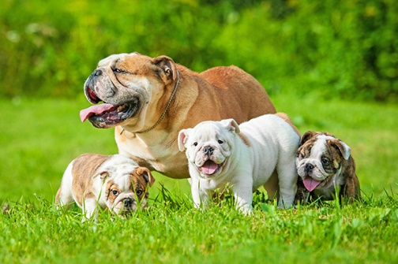
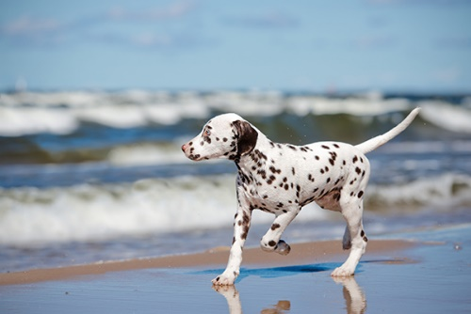
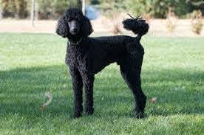
Seven Major Dog Groups
Non-Sporting Group
The breeds of the Non-Sporting Group have two things in common: wet noses and four legs. After that, there’s not much shared by this patchwork group of breeds whose job descriptions defy categorization in the six other groups, though they all have fascinating histories. Today, the varied breeds of the Non-Sporting Group are largely sought after as companion animals, as they were all developed to interact with people in some capacity.
Breeds You May Know:
Bulldog
Dalmatian
Poodle

Slide 30
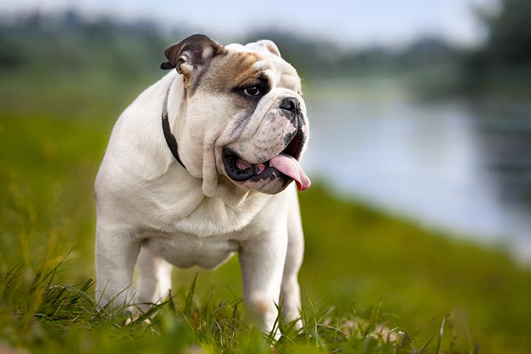
Bulldog
Height: 14-15 inches
Weight: 50 pounds (male), 40 pounds (female)
Life Expectancy: 8-10 years
You can’t mistake a Bulldog for any other breed. The loose skin of the head, furrowed brow, pushed-in nose, small ears, undershot jaw with hanging chops on either side, and the distinctive rolling gait all say “I’m a Bulldog!” The coat, seen in a variety of colors and patterns, is short, smooth, and glossy. But don’t mistake their easygoing ways for laziness—Bulldogs enjoy brisk walks and need regular moderate exercise, along with a careful diet, to stay trim. Summer afternoons are best spent in an air-conditioned room as a Bulldog’s short snout can cause labored breathing in hot and humid weather.

Slide 31
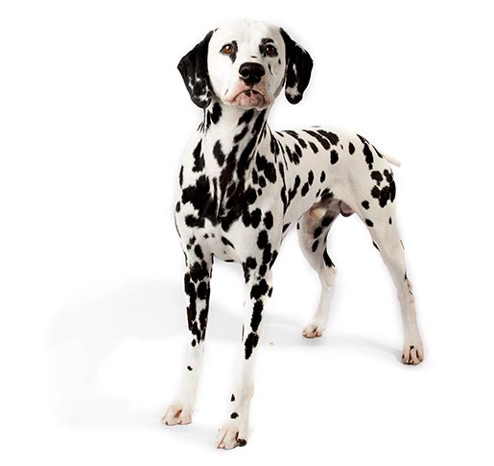
Dalmatian
Height: 19-24 inches
Weight: 45-70 pounds
Life Expectancy: 11-13 years
The Dalmatian’s delightful, eye-catching spots of black or liver adorn one of the most distinctive coats in the animal kingdom. Beneath the spots is a graceful, elegantly proportioned trotting dog. Dals are muscular, built to go the distance; the powerful hindquarters provide the drive behind the smooth, effortless gait.
The Dal was originally bred to guard horses and coaches, and some of the old protective instinct remains. Reserved and dignified, Dals can be aloof with strangers and are dependable watchdogs. With their preferred humans, Dals are bright, loyal, and loving house dogs. They are strong, active athletes with great stamina—a wonderful partner for runners and hikers.

Slide 32
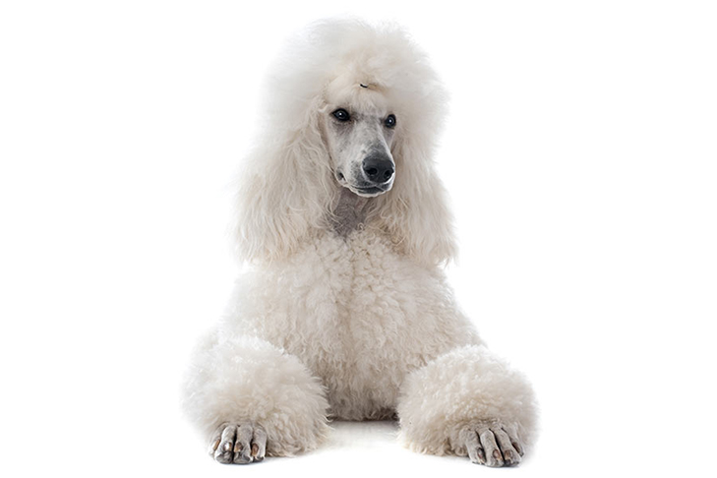
Poodle
Height: Over 15 inches (standard)
Weight: 60-70 pounds (male), 40-50 pounds (female)
Life Expectancy: 10-18 years
Poodles come in three size varieties: Standards should be more than 15 inches tall at the shoulder; Miniatures are 15 inches or under; Toys stand no more than 10 inches. All three varieties have the same build and proportions. Poodles are eager, athletic, and smart dogs of remarkable versatility. The Standard, with his greater size and strength, is the best all-around athlete of the family, but all Poodles can be trained with great success.

Slide 33
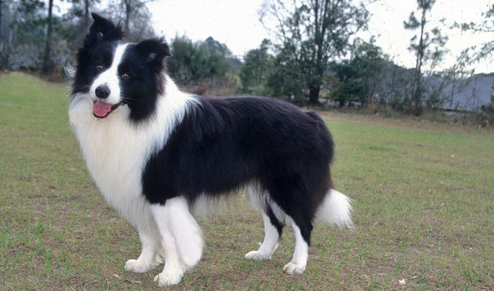
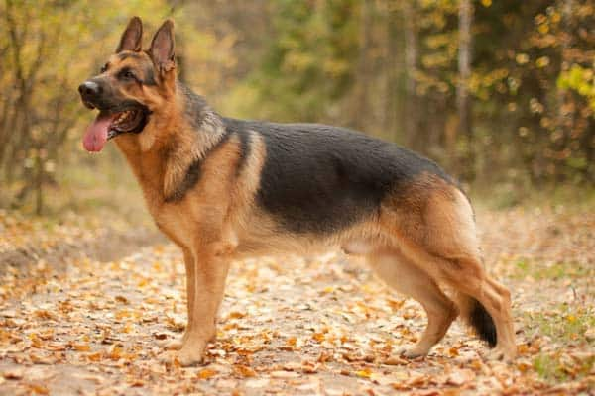
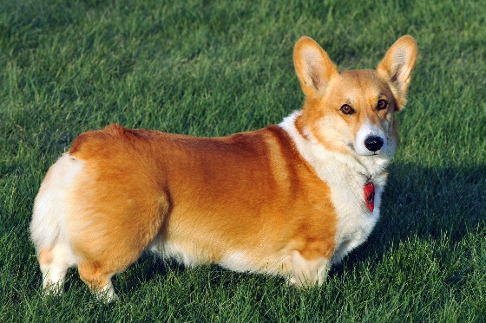
Seven Major Dog Groups
Herding Group
The Herding Group comprises breeds developed for moving livestock, including sheep, cattle, and even reindeer. Herding dogs work closely with their human shepherds, and their natural intelligence and responsiveness makes them highly trainable. Today, some Herding breeds, such as the German Shepherd Dog, are commonly trained for police work. The high levels of energy found in Herding Group breeds means finding them a job is recommended, lest they begin herding your children at home.
Breeds You May Know:
Border Collie
German Shepherd
Pembroke Welsh Corgi

Slide 34
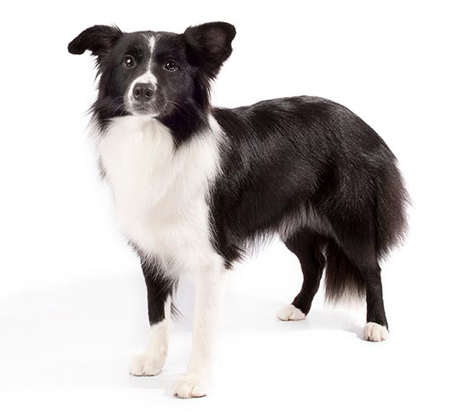
Border Collie
Height: 19-22 inches (male), 18-21 inches (female)
Weight: 30-55 pounds
Life Expectancy: 12-15 years
Borders are athletic, medium-sized herders. The overall look is that of a muscular but nimble worker. Both the rough coat and the smooth coat come in a variety of colors and patterns.
The intense gaze, the Border’s famous “herding eye”, is a breed hallmark. Borders are among the most agile, balanced, and durable dogs.
The intelligence, athleticism, and trainability of Borders have a perfect outlet in agility training. Having a job to perform, like agility—or herding or obedience work—is key to Border happiness. Amiable among friends, they may be reserved with strangers.

Slide 35
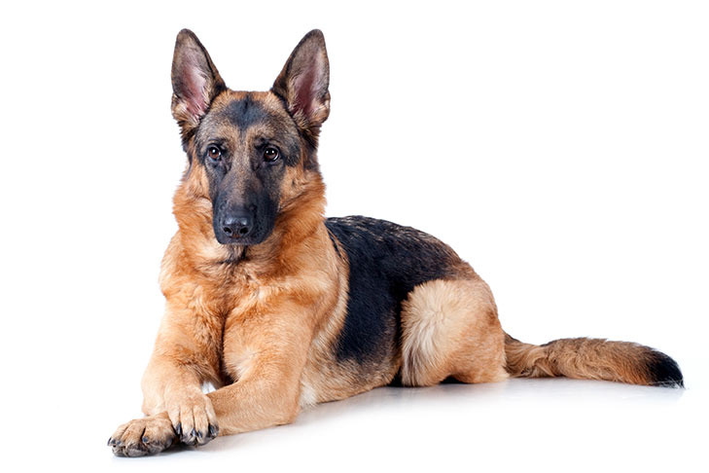
German Shepherd
Height: 24-26 inches (male), 22-24 inches (female)
Weight: 65-90 pounds (male), 50-70 pounds (female)
Life Expectancy: 7-10 years
German Shepherd Dogs when viewed in outline, presents a picture of smooth, graceful curves rather than angles. The natural gait is a free-and-easy trot, but they can turn it up a notch or two and reach great speeds.
Their defining attribute is character: loyalty, courage, confidence, the ability to learn commands for many tasks, and the willingness to put their life on the line in defense of loved ones.
German Shepherds will be gentle family pets and steadfast guardians, but there’s a “certain aloofness that does not lend itself to immediate and indiscriminate friendships.”

Slide 36
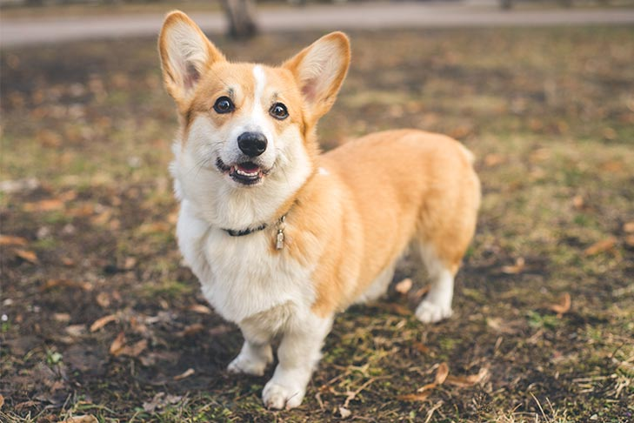
Pembroke Welsh Corgi
Height: 10-12 inches
Weight: up to 30 pounds (male), up to 28 pounds (female)
Life Expectancy: 12-13 years
The Pembroke Welsh Corgi is a cattle herding dog breed that originated in Pembrokeshire, Wales. Short but powerful legs, muscular thighs, and a deep chest equip him for a hard day’s work. Built long and low, Pembrokes are surprisingly quick and agile. They can be red, sable, fawn, and black and tan, with or without white markings.
The Pembroke is a bright, sensitive dog who enjoys play with his human family and responds well to training. As herders bred to move cattle, they are fearless and independent. They are vigilant watchdogs, with acute senses and a “big dog” bark.

Slide 37
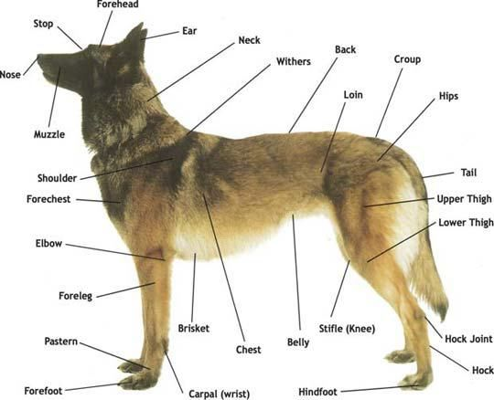
Requirement 2
Point out on a dog or a sketch at least 10 body parts. Give the correct name of each one.

Slide 38
Requirement 3
Do the following:
Explain the importance of house-training, obedience training, and socialization training for your dog.
Explain what "responsible pet ownership" means.
Explain what issues (including temperament) must be considered when deciding on what breed of dog to get as a family pet.

Slide 39
House Training
House-training your dog or puppy requires patience, commitment and lots of consistency. Accidents are part of the process.
Establish a routine. Puppies do best on a regular schedule. The schedule teaches them that there are times to eat, times to play and times to do their business. Generally speaking, a puppy can control their bladder one hour for every month of age. So if your puppy is two months old, they can hold it for about two hours.
Take your puppy outside frequently—at least every two hours—and immediately after they wake up, during and after playing, and after eating or drinking.
Pick a bathroom spot outside, and always take your puppy (on a leash) to that spot. While your puppy is relieving themselves, use a specific word or phrase that you can eventually use before they go to remind them what to do.

Slide 40
House Training
Reward your puppy every time they eliminate outdoors. Praise or give treats—but remember to do so immediately after they’ve finished, not after they come back inside. Rewarding your dog for going outdoors is the only way to teach what's expected of them. Before rewarding, be sure they’re finished.
Put your puppy on a regular feeding schedule. What goes into a puppy on a schedule comes out of a puppy on a schedule. Depending on their age, puppies usually need to be fed three or four times a day. Feeding your puppy at the same times each day will make it more likely that they'll eliminate at consistent times as well, making housetraining easier for both of you.
Pick up your puppy's water dish about two and a half hours before bedtime to reduce the likelihood that they'll need to relieve themselves during the night. Most puppies can sleep for approximately seven hours without needing a bathroom break.
Clean up an accident immediately and thoroughly. Any odor left behind will make that area an attractive bathroom location

Slide 41
House Training

Slide 42
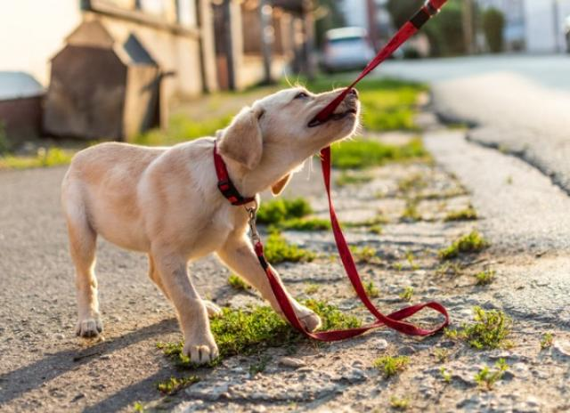
The Importance of Obedience Training
One of the responsibilities of being a dog owner is making sure that you get the obedience training your dog needs.
The main point of getting your canine the training it needs is for the well-being and safety of the dog.
In order to have your dog act socially and interact with other people and pets, they should go through obedience training first. This helps to ensure they will know how to act and react which can avoid problems like barking, biting and other antisocial behavior.

Slide 43
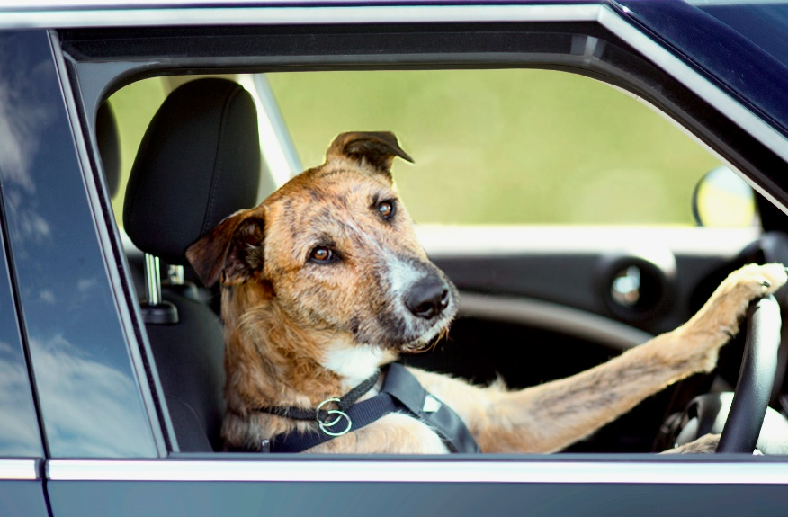
Responsible Pet Ownership
The benefits of pet ownership come with responsibilities. These include:
Lifelong care of the pet. This means committing to the relationship for your pet's entire life.
Selecting a pet that is suited to your home and lifestyle and avoiding impulsive decisions.
Recognizing that owning a pet(s) requires an investment of time and money.
Keeping only the type and number of pets for which you can provide an appropriate and safe environment. This includes appropriate food, water, shelter, health care and companionship.

Slide 44
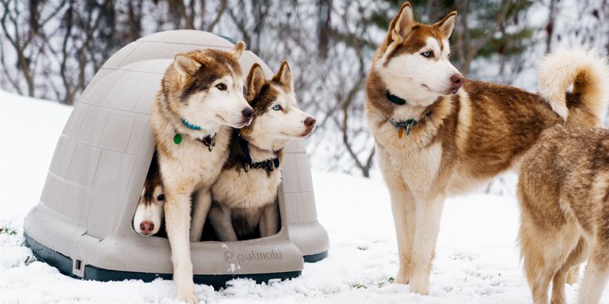
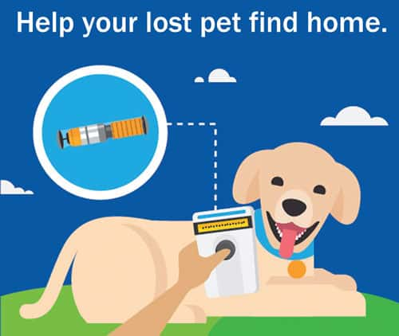
Responsible Pet Ownership
Owning a pet is a privilege and should result in a mutually beneficial relationship. The benefits of pet ownership come with responsibilities. These include:
Keeping only the type and number of pets for which you can provide an appropriate and safe environment. This includes appropriate food, water, shelter, health care and companionship.
Animals that spend extended periods of time outside require habitats that protect their health, safety, and welfare. Outdoor confinement of an animal should include provisions to minimize distress or discomfort to the animal, and assure access to appropriate food, water, and shelter from extreme weather conditions.
Ensuring pets are properly identified (i.e., tags, microchips, or tattoos) and that their registration information in associated databases is kept up-to-date

Slide 45
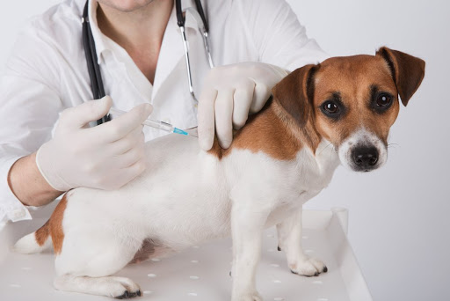
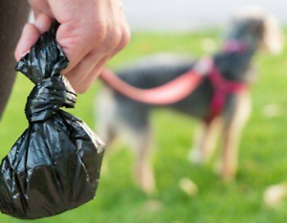
Responsible Pet Ownership
Adhering to local ordinances, including licensing and leash requirements.
Helping to manage overpopulation by controlling your pet(s)' reproduction through managed breeding, containment, or spay/neuter. Establishing and maintaining a veterinarian-client-patient relationship.
Providing preventive (e.g., vaccinations, parasite control) and therapeutic health care for the life of your pet(s) in consultation with, and as recommended by, your veterinarian.
Socialization and appropriate training for your pet(s) to facilitate their well-being and the well-being of other animals and people.
Preventing your pet(s) from negatively impacting other people, animals and the environment. This includes proper waste disposal, noise control, and not allowing pet(s) to stray or become feral.

Slide 46
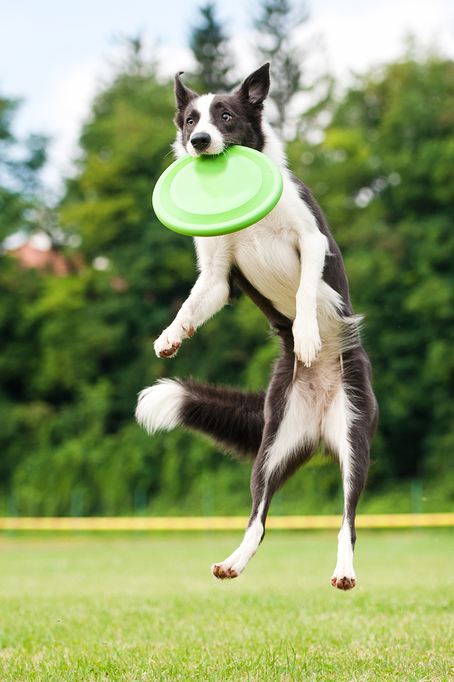
Responsible Pet Ownership
Providing exercise and mental stimulation appropriate to your pet(s)' age, breed, and health status.
Include your pets in your planning for an emergency or disaster, including assembling an evacuation kit.
Making arrangements for the care of your pet when or if you are unable to do so.
Recognizing declines in your pet(s)' quality of life and making decisions in consultation with your veterinarian regarding appropriate end-of-life care (e.g., palliative care, hospice, euthanasia).

Slide 47
Tips for Choosing the Right Dog Breed for a Family Pet
Make a Checklist
Have I chosen a pet that will fit into my home and lifestyle?
Do I have the financial resources to take care of a pet?
Do I have the time to walk, groom, train and pay attention to a pet?
Whatever you do, don’t make getting a dog an impulse decision. This dog will be part of your life for years to come so do plenty of research before making the commitment.

Slide 48
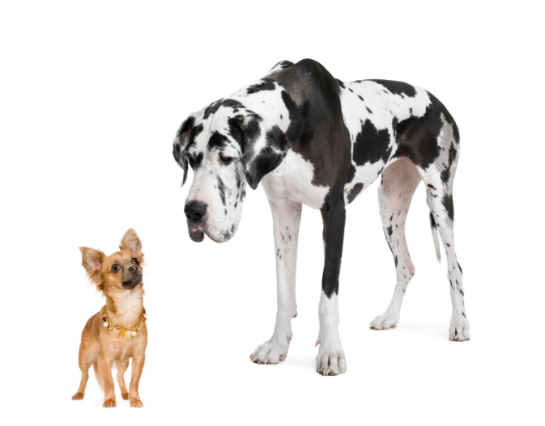
Tips for Choosing the Right Dog Breed for a Family Pet
Not One Size Fits All
What size dog should you bring home? As you narrow down the type of dog that will fit best into your lifestyle, think about what size dog will fit into your home.
If you live in an apartment you probably shouldn’t bring home a Great Dane. But don’t let size fool you — it doesn’t equate to the amount of exercise that dog needs. Small dogs tend to be more hyper and need to be worn out. Big dogs also require exercise but tend to be a little lazier. They also need a lot of attention.
Apartment dwellers should also ask themselves if they’re willing to walk up and down flights of stairs six times a day to exercise their dog early in the morning and late at night.
If you live in rural area, ask yourself where the dog will spend most of its time. For example, a petite Pomeranian might be the groomer’s worst nightmare with dirt, bugs and stickers constantly tangled in its long, silky hair.

Slide 49
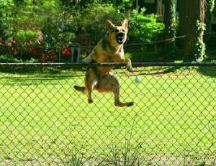
Tips for Choosing the Right Dog Breed for a Family Pet
Will Your Dog Need Training?
Training your dog is benefit to you, the neighbors and the greater dog community. Even if you send your dog to obedience training you will still need to dedicate time to working with him on a regular basis. Some dogs also need socialization training if they are shy or skittish.
If your dog is going to spend time in the yard, make sure there’s a proper fence so that she doesn’t pay your neighbors an uninvited visit. Keep your pup on a leash when required to do so.

Slide 50
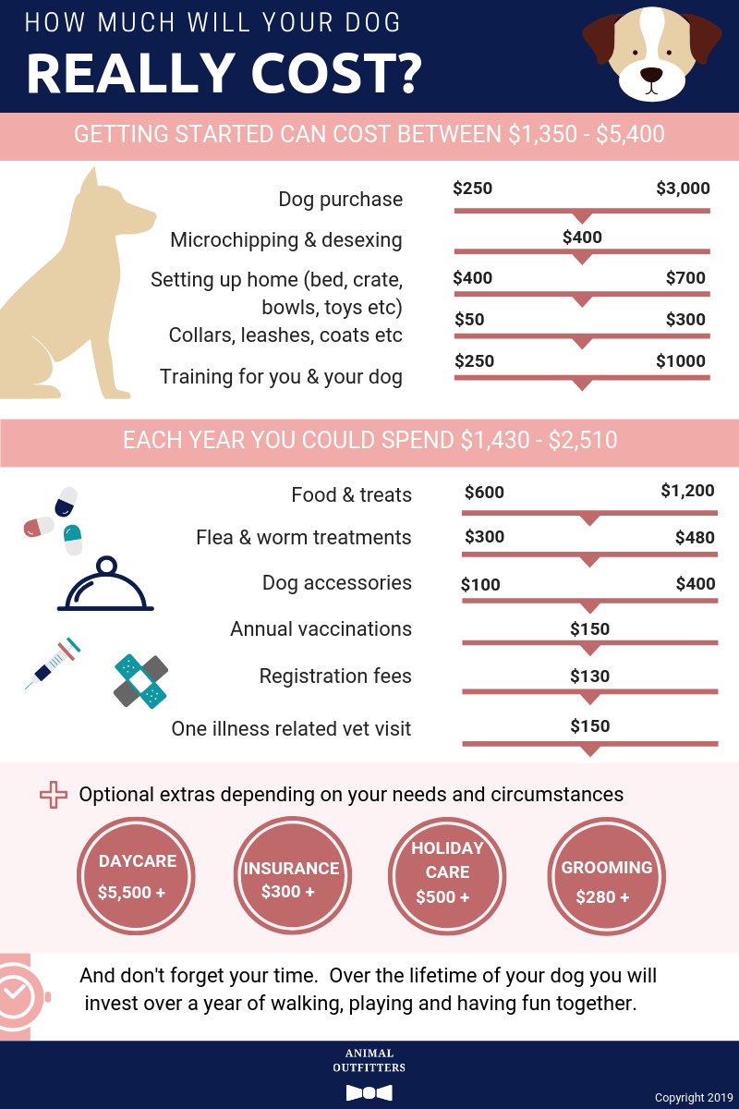
Tips for Choosing the Right Dog Breed for a Family Pet
Be Prepared to Pay for Expenses
Did you know the cost of a pet over its lifetime can cost as much as $20,000? These costs range from veterinary visits for routine vaccines and teeth cleanings to unexpected illnesses and accidents.
All the little things add up, too: Microchipping, grooming, leashes, dog bowls, food, flea medication, doggie doors and a dog bed to snooze on.
If cost is an issue, a great alternative to buying a purebred is adopting a dog from a rescue shelter. The cost isn’t only significantly lower but you get the benefit of getting multiple breeds in one. There are thousands of dogs available in cities across the country.

Slide 51
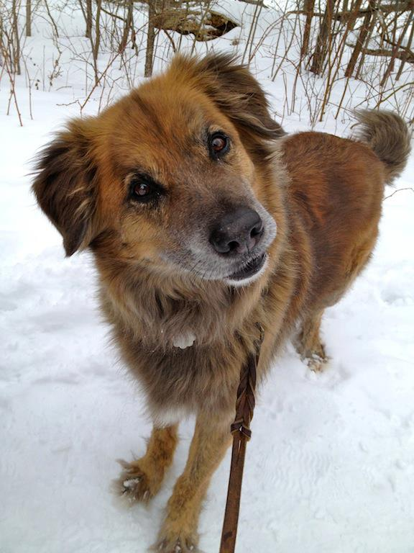
Tips for Choosing the Right Dog Breed for a Family Pet
Do You Want a Pure-Breed Dog or a Mutt?
Picking the right breed is easy if you do enough research. Again, take your lifestyle into consideration when picking a pet. Have I chosen a pet that will fit into my home and lifestyle?
The toy group are great for small spaces. These dogs might be little but they are tough, hyper and playful.
The herding group are great for farms and ideal for families. They are great companions and responsive to training.
Terriers are generally energetic across the board. These dogs have strong personality that requires owners who are willing to put up with a little attitude.
Dogs from the working group are ideal watchdogs. They are fast learners, intelligent and excellent companions but aren’t always ideal for families with children.

Slide 52
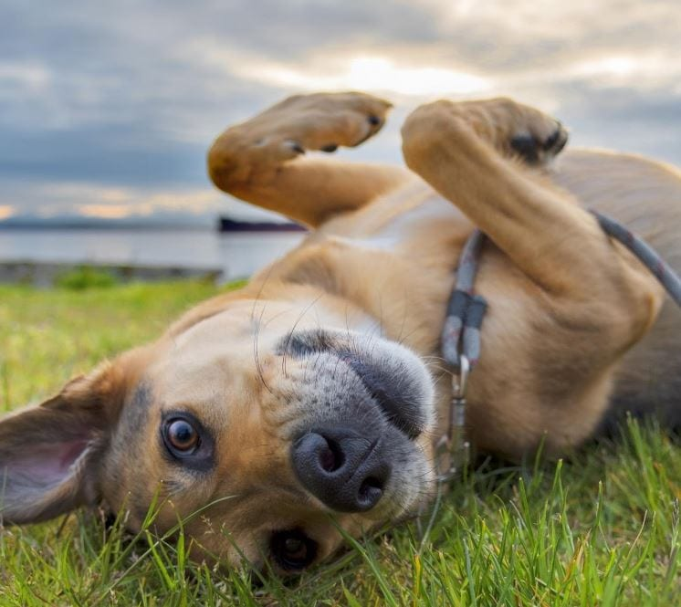
Tips for Choosing the Right Dog Breed for a Family Pet
Do You Want a Pure-Breed Dog or a Mutt (continued)?
Hound dogs are known for their endless energy and hunting traits. Many make great family pets.
Sporting dogs enjoy outings, particularly the type of activity where they can rum and roam free. They require regular, vigorous exercise.
Non-sporting dogs are known as friendly and sturdy dogs, they range in size as well as personality, coat and size.
Mutts can be the right combination of personality, endurance, size, behavior tendencies as a result of mixed bloodline and a unique appearance (no one else's dog will look or act like yours!).

Slide 53
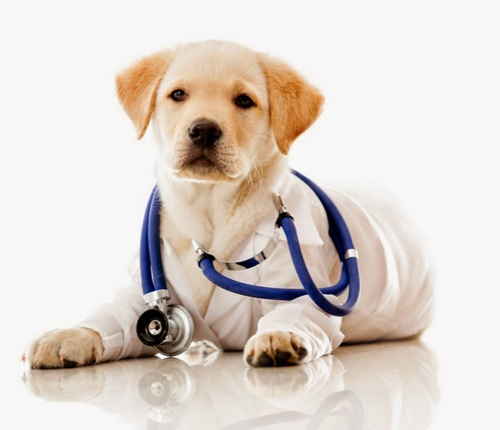
Tips for Choosing the Right Dog Breed for a Family Pet
Make a Healthy Choice
When evaluating a puppy or an adult dog, the dog should appear friendly and outgoing.
Puppies should be playful, not shy or anxious.
Make sure the dog’s eyes are bright and shiny and have no discharge.
The inner eyelids should be smooth and pink.
Check the dog’s ears for debris.
The skin should feel warm and dry to the touch.
The dog’s coat should be clean and smelling.
The dog should be in good form and build, not extremely fat or thin.

Slide 54
Requirement 4
For two months, keep and care for your dog. Maintain a log of your activities during this period that includes these items: feeding schedule, types of food used, amount fed, exercise periods, training schedule, a weekly body weight record, grooming and bathing schedules, veterinary care, if necessary, and costs. Also include a brief description of the type of housing/shelter arrangements you have for your dog.

Slide 55
Dog Care Log

Slide 56
Exercise Schedule
How Much Exercise Does a Dog Need Every Day?
The answer varies from dog to dog and is dependent on age, health, and breed. There are a few standard guidelines you can follow, however, to make sure that your dog is getting all the exercise she needs.
Puppies generally have more energy than adult dogs and so require more exercise in short bursts. Since puppies are constantly growing, including several short walks or play sessions throughout the day is a safer choice than going for one really long walk, as this can be too hard on your puppy’s developing body.
How Much Exercise Does an Adult Dog Need?
Your dog’s breed heavily influences the level of physical activity he needs. High-energy breeds, such as Border Collies, require a lot more exercise than low-energy breeds like the Basset Hound.
Benefits of Exercise for Dogs
Big or small, young or old, dogs need to exercise daily. While the age and breed of your dog may affect your dog’s ability to exercise, all dogs still need to take part in some form of daily physical activity.
Exercise tones a dog’s muscles, helps the body and metabolic system to function properly, and engages the mind.

Slide 57
Housing/Shelter Arrangements
Many dogs live indoors with their owners, while others spend most of their lives outside.
All dogs are not necessarily outdoor dogs. Most small and/or short-haired dogs could freeze outside in winter temperatures.
Dogs that live outdoors should have access to adequate food, water, and shelter at all times.

Slide 58
Requirement 5
Explain the correct way to obedience train a dog and what equipment you would need. Show with your dog any three of these commands: "come", "sit", "down", "heel", "stay", "fetch" or "get it", and "drop it".

Slide 59
Obedience Training
5 Essential Commands You Can Teach Your Dog
Sit is one of the easiest dog obedience commands to teach, so it’s a good one to start with.
Hold a treat close to your dog’s nose.
Move your hand up, allowing his head to follow the treat and causing his bottom to lower.
Once he’s in sitting position, say “Sit,” give him the treat, and share affection.
Repeat this sequence a few times every day until your dog has it mastered. Then ask your dog to sit before mealtime, when leaving for walks, and during other situations where you’d like him calm and seated.

Slide 60
Obedience Training
5 Essential Commands You Can Teach Your Dog
Come is a command that can help keep a dog out of trouble, bringing him back to you if you lose grip on the leash or accidentally leave the front door open.
Put a leash and collar on your dog.
Go down to his level and say, “Come,” while gently pulling on the leash.
When he gets to you, reward him with affection and a treat.
Once he’s mastered it with the leash, remove it — and practice the command in a safe, enclosed area.

Slide 61
Obedience Training
5 Essential Commands You Can Teach Your Dog
Down can be one of the more difficult commands in dog obedience training. Why? Because the position is a submissive posture. You can help by keeping training positive and relaxed, particularly with fearful or anxious dogs.
Find a particularly good smelling treat , and hold it in your closed fist.
Hold your hand up to your dog’s snout. When he sniffs it, move your hand to the floor, so he follows.
Then slide your hand along the ground in front of him to encourage his body to follow his head.
Once he’s in the down position, say “Down,” give him the treat , and share affection.
Repeat it every day. If your dog tries to sit up or lunges toward your hand, say “No” and take your hand away. Don’t push him into a down position, and encourage every step your dog takes toward the right position. After all, he’s working hard to figure it out!

Slide 62
Obedience Training
5 Essential Commands You Can Teach Your Dog
Stay. Before attempting this one, make sure your dog is an expert at the “Sit” command.
First, ask your dog to “Sit.”
Then open the palm of your hand in front of you, and say “Stay.”
Take a few steps back. Reward him with a treat and affection if he stays.
Gradually increase the number of steps you take before giving the treat .
Always reward your pup for staying put — even if it’s just for a few seconds.
This is an exercise in self-control for your dog, so don’t be discouraged if it takes a while to master, particularly for puppies and high-energy dogs. After all, they want to be on the move and not just sitting there waiting.

Slide 63
Obedience Training
5 Essential Commands You Can Teach Your Dog
Leave It
This can help keep your dog safe when his curiosity gets the better of him, like if he smells something intriguing but possibly dangerous on the ground! The goal is to teach your pup that he gets something even better for ignoring the other item.
Place a treat in both hands.
Show him one enclosed fist with the treat inside, and say, “Leave it.”
Let him lick, sniff, mouth, paw, and bark to try to get it — and ignore the behaviors.
Once he stops trying, give him the treat from the other hand.
Repeat until your dog moves away from that first fist when you say, “Leave it.”
Next, only give your dog the treat when he moves away from that first fist and also looks up at you.
Once your dog consistently moves away from the first treat and gives you eye contact when you say the command, you’re ready to take it up a notch. For this, use two different treats — one that’s just all right and one that’s a particularly good smelling and tasty favorite for your pup.

Slide 64
Obedience Training
5 Essential Commands You Can Teach Your Dog
Leave It (continued)
Say “Leave it,” place the less attractive treat on the floor, and cover it with your hand.
Wait until your dog ignores that treat and looks at you. Then remove that treat from the floor, give him the better treat and share affection immediately.
Once he’s got it, place the less tasty treat on the floor… but don’t completely cover it with your hand. Instead hold it a little bit above the treat. Over time, gradually move your hand farther and farther away until your hand is about 6 inches above.
Now he’s ready to practice with you standing up! Follow the same steps, but if he tries to snatch the less tasty treat, cover it with your foot.
Don’t rush the process. Remember, you’re asking a lot of your dog. If you take it up a notch and he’s really struggling, go back to the previous stage.
Just these five simple commands can help keep your dog safer and improve your communication with him. It’s well worth the investment of your time and effort. Remember, the process takes time, so only start a dog obedience training session if you’re in the right mindset to practice calm-assertive energy and patience.

Slide 65
Socialization Training
Once your puppy has received all of their vaccines, here are a few ideas for socialization:
Lace up your walking shoes and take your pal around town for some enriching experiences, including new smells and different environments.
Enroll in doggy daycare, so your pup can engage in some structured social interactions with pals around the same age and socialize through play.
Don’t be afraid of a little noise. Let your pup hear a variety of household sounds, such as the vacuum cleaner, lawn mower, hair dryer, dishwasher, and so on. These sensory experiences can help your pooch get comfortable around foreign sounds, often ones that are loud and unexpected.
Embrace the herd mentality and introduce your puppy to lots of different dogs and people. The more people and pooches they can encounter, the more likely they are to become socialized and comfortable with new experiences.

Slide 66
Requirement 6
Do the following:
Discuss the proper vaccination schedule for a dog in your area from puppyhood through adulthood.
Discuss the control methods for preventing fleas, ticks, heartworms, and intestinal parasites (worms) for a dog in your area from puppyhood through adulthood.
Explain the importance of dental care and tooth brushing to your pet's health.
Discuss the benefits of grooming your dog's coat and nails on a regular basis.
Discuss with your counselor any seasonal conditions (like hot summers, cold winters, or extreme humidity) where you live that need to be considered for your dog.
Discuss with your counselor the considerations and advantages of spaying or neutering your dog.

Slide 67
Vaccination Schedule

Slide 68
Parasite Prevention - Fleas
As with most things… prevention is easier (and cheaper) than treatment.
Fleas can survive and thrive in your home even during the winter and in the absences of pets for months!
For flea prevention to be effective, ALL pets in the household need to be on monthly treatment.

Slide 69
Parasite Prevention - Fleas
Speak with your veterinarian for recommended products. There are lots of options - from chewable pills, topical "spot-ons", and many others. There are even some safe and effective flea collars these days, too.
While flea preventative medications are the most effective tool for preventing an infestation, cleaning is also a big help. You should regularly vacuum your carpets and wash any bedding on which your pets sleep – including your own. This will help to kill any fleas or larvae, and remove any flea ‘dirt’ that may occasionally get into the home.

Slide 70
Parasite Prevention - Ticks
Regularly inspect your dogs (even if they are taking a tick preventative) and yourself for ticks after walks through the woods or grassy settings. Feel for bumps all over your dog, and part the fur to check out any bumps you do feel.
The quicker you remove a tick, the less likely your dog will contract a secondary illness related to tick bites. Learn the proper method of tick removal. Invest in a pair of fine tweezers or a tick removal tool used for this purpose. It’s best to wear gloves and remove the tick by the head. If you are unable to remove the tick, call your veterinarian.
Keep grass in your yard mowed as short as possible. Refrain from walking into grassy patches in endemic tick areas if you can. The Centers for Disease Control and Prevention also suggests removing leaf litter, tall grasses, and brush from your yard.

Slide 71
Parasite Prevention - Heartworm
Heartworm disease is a serious disease that results in severe lung disease, heart failure, other organ damage, and death in dogs. It is caused by a parasitic worm called Dirofilaria immitis. The worms are spread through the bite of a mosquito. The dog is the definitive host, meaning that the worms mature into adults, mate, and produce offspring while living inside a dog. The mosquito is the intermediate host, meaning that the worms live inside a mosquito for a short transition period in order to become infective (able to cause heartworm disease). The worms are called “heartworms” because the adults live in the heart, lungs, and associated blood vessels of an infected animal.
Heartworm disease is not contagious, meaning that a dog cannot catch the disease from being near an infected dog. Heartworm disease is only spread through the bite of a mosquito.

Slide 72
Parasite Prevention - Heartworm
Warning Symptoms of Heartworms in Dogs
Heartworm disease in dogs is known as a silent killer, because it can take months before your dog shows symptoms. In the early stages of infection, most dogs show little to no symptoms at all, and the more the disease progresses, the more likely apparent symptoms will develop. Pay attention to these warning signs of heartworms in dogs, and take your pet to the vet if these symptoms persist.
A dry unproductive cough. Once heartworms make their way into the lungs and begin reproducing in the lungs and surrounding veins, your dog will begin exhibiting a dry cough, typically after exercising. In some cases, these coughing fits might end in fainting, even after light exercise.
Inactivity or laziness. Pay attention to your dog’s energy levels. If your pet seems more tired than usual, doesn’t want to go outside, or partake in physical activity, there is a good chance that your pet is sick. Dogs with heartworm infections will feel weaker, and will find it harder to remain active, even in low-energy activities.

Slide 73
Parasite Prevention - Heartworm
Warning Symptoms of Heartworms in Dogs (continued)
Weight loss and loss of appetite. In more advanced stages of heartworm infections, your dog will find it hard to complete normal physical tasks like eating. If you notice weight loss and a lack appetite in your dog, then you should take him to the vet immediately to rule out heartworms and other illnesses.
Shallow and rapid breathing. When worms inhabit your dog’s lungs and the surrounding veins, respiratory problems will also occur. Along with coughing, the areas around the blood vessels in the lungs will begin to retain fluid, making it harder for your dog to receive oxygen, resulting in shallow, more rapid breaths.

Slide 74
Parasite Prevention - Heartworm
Warning Symptoms of Heartworms in Dogs (continued)
Distended chest. A swollen, bulged, or distended chest is typically a symptom of an adult heartworm infection. Usually this symptom is caused by weight loss, anorexia, and fluid buildup.
Allergic reactions. While symptoms of allergic reactions are more common in cats with heartworms, dogs may also sometimes exhibit asthmatic symptoms similar to an allergic reaction in response to heartworm infection.
Collapsing or fainting. Once a large population of heartworms enter the heart and causes a blockage of blood flow, known as caval or vena cava syndrome, fainting will occur. Collapsing usually correlates with shock and red blood cell destructions. At this point, the disease has progressed to a level where death can occur within days.

Slide 75
Parasite Prevention - Heartworm
A veterinarian uses blood tests to check a dog for heartworms.
Dogs that are 7 months of age and older should be tested for heartworms before starting heartworm prevention.
If a heartworm-positive dog is not tested before starting a preventive, the dog will remain infected with adult heartworms until it gets sick enough to show symptoms.
Heartworm preventives do not kill adult heartworms.
Giving a heartworm preventive to a dog infected with adult heartworms may be harmful or deadly.
Year-round prevention is best! Talk to your dog’s veterinarian to decide which preventive is best for your dog.

Slide 76
Parasite Prevention – Intestinal (Worms)
Symptoms of intestinal worms in dogs
Scooting on their bottom
Worms or worm segments being visible in your dog’s feces.
Bloody or mucoid feces
Diarrhea
Vomiting
Swollen abdomen
Lethargy
Nutritional deficiencies
Dehydration
Coughing
Anemia and even death
To determine if your dog has worms, and which kind of worms, your veterinarian will complete a physical exam and take a stool sample for a fecal examination.

Slide 77
Parasite Prevention – Intestinal (Worms)
There are many safe ways to de-worm your dog. The sooner the worms are gone, the sooner your pet will get healthy and feel better.
Your vet will give your dog medicine by mouth or in a shot to kill the worms.
Many of these drugs are described as “broad-spectrum,” because they're good for treating a wide range of parasites, including worms that live in the gut. They're poisonous to pests, but safe for pets.

Slide 78
Parasite Prevention – Intestinal (Worms)
Roundworms and Hookworms are little worm like parasites that live in the intestinal tract of dogs. They cause discomfort to the pet and can cause illness and upset stomach. In extreme cases where a pet does not receive dewormers or care, they can cause death.
Tapeworms are long, flat, and segmented. They live in the intestines of many animals and can be passed from wildlife to domestic animals. Tapeworms do not have mouths but rather, suckers that attach to the intestines. You may see tapeworms being passed from your pet in broken, segmented pieces during defecation.
Whipworm – are thin but have an arrow shape to them as they get wider down the body. They cause illness in pets and can lead to death.

Slide 79
Parasite Prevention – Intestinal (Worms)
To determine if your dog has worms, and which kind of worms, your veterinarian will complete a physical exam and take a stool sample for a fecal examination.
There are many safe ways to de-worm your dog. The sooner the worms are gone, the sooner your pet will get healthy and feel better.
Your vet will give your dog medicine by mouth or in a shot to kill the worms. Many of these drugs are described as “broad-spectrum,” because they're good for treating a wide range of parasites, including worms that live in the gut. They're poisonous to pests, but safe for pets.

Slide 80
Dental Care
Your pet’s teeth should be checked at least once a year by your veterinarian for early signs of a problem and to keep your pet’s mouth healthy.
Prevention of the most common oral disease in pets consists of frequent removal of the dental plaque and tartar that forms on teeth that are not kept clean.
Regularly brushing your pet’s teeth is the single most effective thing you can do to keep their teeth healthy between dental cleanings, and may reduce the frequency or even eliminate the need for periodic dental cleaning by your veterinarian.
Daily brushing is best, but it’s not always possible and brushing several times a week can be effective. Most dogs accept brushing.

Slide 81
Dog Grooming
Groom regularly. Certain breeds—including Shih Tzu's and Pomeranians—should be brushed often. Dogs’ nails should be trimmed regularly
Be patient. Dogs can sense your stress, so make sure that you’re calm and relaxed, too, and you’ve set aside plenty of time for the grooming session. Go slowly and pay close attention to what you’re doing and your dog’s reaction. Watch for signs of stress, such as trembling, whining, or panting that’s not heat-related, and take a break if needed.
Use appropriate dog-grooming equipment. Use the right brush. Depending on your dog’s fur and skin type, a special brush might be necessary. Similarly, make sure the nail clippers, scissors, trimmer, etc. are all high-quality and appropriate to your dog.
Be mindful that long-haired or double-coated breeds require extensive maintenance. Without regular brushing, these dogs can quickly develop mats on various parts of their bodies,

Slide 82
Seasonal Considerations
In the north, dogs need protection from the wet and cold with a dry, elevated doghouse with clean, dry bedding, and a flap over the entrance in wintertime to keep out drafts.
Check outdoor water bowls often when the temperature is below freezing so it doesn’t ice over as well as increase the amount of food because they will need more calories to keep warm.
In hot and humid conditions, they need air circulation, plenty of clean, fresh water, and shade.

Slide 83
Spaying or Neutering
By spaying or neutering your pet, you’ll help control the pet homelessness crisis, which results in millions of healthy dogs and cats being euthanized in the United States each year simply because there aren’t enough homes to go around.
There are also medical and behavioral benefits to spaying (female pets) and neutering (male pets) your animals.
Here are some of the medical benefits:
Your female pet will live a longer, healthier life. Spaying helps prevent uterine infections and breast tumors, which are malignant or cancerous in about 50 percent of dogs. Spaying your pet before her first heat offers the best protection from these diseases.
Neutering your male companion prevents testicular cancer and some prostate problems.

Slide 84
Spaying or Neutering
Behavioral benefits:
Your spayed female pet won't go into heat which means it also gets rid of the bleeding, nervous behaviors, and crying that comes with the heat cycle.
Your male dog will be less likely to roam away from home. An intact male will do just about anything to find a mate, including finding creative ways escape from the house. Once he's free to roam, he risks injury in traffic and fights with other male animals.
Spayed and neutered animals tend to be more affectionate and calmer.
Spaying/neutering your pets is also highly cost-effective. The cost of your pet's spay/neuter surgery is far less than the cost of having and caring for a litter.
When to Spay or Neuter Your Pet
While the traditional age for neutering is six to nine months, puppies as young as eight weeks old can be neutered as long as they’re healthy. Dogs can be neutered as adults as well, although there’s a slightly higher risk of post-operative complications in older dogs, dogs that are overweight or dogs that have health problems.

Slide 85
Requirement 7
Do the following:
Explain the precautions to take in handling a hurt dog.
Show how to put on an emergency muzzle.
Explain how to treat wounds. Explain first aid for a dog bite.
Show how to put on a simple dressing and bandage the foot, body, or head of your dog.
Explain what to do if a dog is hit by a car.
List the things needed in every dog owner's first-aid kit.
Tell the dangers of home treatment of a serious ailment.
Briefly discuss the cause and method of spread, the signs and symptoms and the methods of prevention of rabies, parvovirus, distemper, and heartworms in dogs.

Slide 86
Handling a Hurt Dog
Approach the dog slowly and quietly, speaking in a comforting tone.
A seriously injured dog is frightened and in pain, and might act unpredictably, even biting its owner. Before you begin first aid, muzzle the dog.
Get the dog into a comfortable position.

Slide 87
Emergency Muzzle
You will need a leash or a piece of gauze, and a pair of scissors.
First create a loop that is about three times the size of your dog’s snout so you can slip it on, tighten it, and then tie into a knot on the top of the nose. Bring the two ends around to create a second loop around the snout. Tie these ends underneath the jaw with another single knot. Once secured around your dog’s muzzle, bring the ends of the gauze or leash (now underneath your dog’s jaw) around the back of the ears. Tie again. The muzzle will be tight enough where your dog is unable to open their mouth but not too tight that they can’t breathe.
Note: You will need to be able to remove the muzzle quickly should your dog start vomiting, so make sure you leave an out! If it isn’t easily removable, scissors can quickly cut through the fabric.

Slide 88
First Aid for a Dog Bite
Place a clean towel over the injury to stop any bleeding.
Try to keep the injured area elevated.
Wash the bite carefully with soap and water.
Apply a sterile bandage to the wound.
Apply antibiotic ointment to the injury every day to prevent infection.
Consult a physician.
If another dog bites yours, treat the wound as you would any puncture wound and consult a veterinarian.

Slide 89
Bandaging a Dog
Clean and disinfect the wound of your dog.
Put a sterile, nonstick, absorbent pad on the wound.
Then wrap a gauze bandage with one-third of the bandage being exposed on each wrap.
Next, wrap a layer of adhesive tape/bandage over the gauge bandage.
Use a strip of sticky tape to connect the fur and the bandage. This will help in keeping the bandage secured from slipping.
Here are additional things that you need to do for extra care depending on the kind of injury:
For leg wounds, wrap roll cotton over the gauze pad, then wrap stretch gauze, and finish with adhesive tape or bandage.
For tail wounds, do the above mentioned steps, but use long materials and secure the bandage on your dog’s tail in case it might fall off from wagging.
For torso wounds, wrap a towel around the torso, or a pillow case. Use pins on the side (opposite of the wound) to secure the bandage.

Slide 90
What to Do if a Dog is Hit by a Car
Don't panic
Move the pet and yourself to a safe location. If there are bystanders, ask them to safely stop traffic and to assist you if you are unable to carry your dog.
Keep the injured dog warm by wrapping them in a blanket, keeping their nose and mouth exposed. Wrapping a dog in a blanket or towel will provide warmth and security. A blanket can also be used as a stretcher for severely injured or weakened dogs.
Cover any wounds with a clean cloth and apply gentle pressure to stop any bleeding
Avoid giving the dog any food or drink immediately after the accident
A makeshift muzzle is critical for you to stay safe and to be available to care for your injured dog. If your dog appears to have difficulty breathing, do not use a muzzle. Instead, use a blanket to wrap your dog, trying to avoid pressure on injured areas and keep your face away from its mouth.
Once your pet has been situated in a transport vehicle, call the nearest veterinary hospital to notify them of the situation and your estimated time of arrival.
Even if you believe your dog has not sustained a major injury as a result from being hit by a car, it is crucial that he or she sees a veterinarian as soon as possible.

Slide 91
Dog Owner's First-Aid Kit
Your Kit Should Contain
Absorbent gauze pads
Adhesive tape
Cotton balls or swabs
Fresh 3% hydrogen peroxide to induce vomiting (always check with veterinarian or animal poison control expert before giving to your pet)
Ice pack
Disposable gloves
Scissors with blunt end
Tweezers
Antibiotic ointment
Oral syringe or turkey baster
Liquid dishwashing detergent (for bathing)
Towels
Small flashlight
Alcohol wipes
Styptic powder
Saline eye solution
Artificial tears
Phone number, clinic name, address of your veterinarian as well as local veterinary emergency clinics.
Make sure to check your pack every few months to make sure nothing has expired or needs to be replaced. And of course keep your kit out of the reach of children.

Slide 92
Dangers of Home Treatment of a Serious Dog Ailment
Consider these risks before treating your pet at home.
Giving Over-the-Counter Drugs Not Intended for Companion Animals. Some human medications work for pets, but unless you’ve talked to your vet first, you’re inviting trouble. Ibuprofen or acetaminophen can cause kidney failure, liver failure, and stomach ulcers.
Giving the Wrong Dosage of Over-the-Counter Drugs. Even a product considered safe for animals can do damage if it’s misdosed.
Giving a Product that Interferes with Prescription Drugs. Over-the-counter products can also adversely interact with vet-prescribed medications.
Treating the Wrong Ailment. That article or friend you consulted may mention symptoms that seem similar to your pet’s, but only vets are trained to detect subtle differences.
Giving Medications Prescribed for Other Pets. Giving a pet a drug prescribed for another pet—even for the same breed—can result in several complications.
Waiting Too Long to See a Vet. When in doubt about your pet’s health, call your veterinarian. Most veterinary clinics would prefer for a pet owner to call and ask questions instead of administering a medication or supplement without direction.”

Slide 93
What is Rabies?
Rabies is a virus that affects the brain and spinal cord of all mammals, including dogs, cats and humans.
Since animals who have rabies secrete large amounts of virus in their saliva, the disease is primarily passed to dogs through a bite from an infected animal. It can also be transmitted through a scratch or when infected saliva makes contact with mucous membranes or an open, fresh wound. The risk runs highest if your dog-or any pet-is exposed to wild animals.
The most common carriers of the rabies virus in this country are bats, raccoons, skunks and foxes.

Slide 94
Symptoms of Rabies
Initially, a dog who’s become infected may show extreme behavioral changes such as restlessness or apprehension, both of which may be compounded by aggression. Friendly dogs may become irritable, while normally excitable animals may become more docile. A dog may bite or snap at any form of stimulus, attacking other animals, humans and even inanimate objects. They may constantly lick, bite and chew at the site where they were bitten. A fever may also be present at this stage.
As the virus progresses, an infected dog may become hypersensitive to touch, light and sound. They may eat unusual things and hide in dark places. Paralysis of the throat and jaw muscles may follow, resulting in the well-known symptom of foaming at the mouth.
Disorientation, incoordination and staggering may occur, caused by paralysis of the hind legs.
Other classic signs of rabies include loss of appetite, weakness, seizures and sudden death.

Slide 95
Incubation, Diagnosis, and Treatment of Rabies
The virus usually incubates from two to eight weeks before signs are noticed. However, transmission of the virus through saliva can happen as early as ten days before symptoms appear
There is no accurate test to diagnose rabies in live animals. The most accurate test for diagnosis can only be performed after the death of the animal.
There is no treatment or cure for rabies once symptoms appear. Since rabies presents a serious public health threat, dogs who are suspected of having the virus are most often euthanized.

Slide 96
How Can Rabies be Prevented?
Keeping your dog up to date with vaccinations is not only essential to prevention, it’s the law. Check with your veterinarian about the right vaccine and vaccination schedule for your dog. In many areas of the country, it’s mandatory that all domestic dogs and cats are vaccinated after the age of three months.
Vaccinating your pet not only protects him from getting rabies, it protects him if he bites someone. Dogs who have bitten humans are required to be confined for at least 10 days to see if rabies develops, and if the animal’s vaccination records are not current, a lengthy quarantine or even euthanasia may be mandated. If you’re not sure of the laws in your town, consult your local animal affairs agency.
Avoiding contact with wild animals is also necessary to prevention. You may greatly decrease chances of rabies transmission by walking your dog on a leash, and supervising him while he’s outdoors.

Slide 97
Parvovirus
Canine parvovirus is a highly contagious virus that can affect all dogs, but unvaccinated dogs and puppies younger than four months old are the most at risk.
Dogs that are ill from canine parvovirus infection are often said to have "parvo."
The virus affects dogs' gastrointestinal tracts and is spread by direct dog-to-dog contact and contact with contaminated feces (stool), environments, or people.

Slide 98
Signs of Parvovirus
Some of the signs of parvovirus include lethargy; loss of appetite; abdominal pain and bloating; fever or low body temperature (hypothermia); vomiting; and severe, often bloody, diarrhea.
Persistent vomiting and diarrhea can cause rapid dehydration, and damage to the intestines, immune system, and can cause septic shock.

Slide 99
Diagnosis and Treatment of Parvovirus
Most deaths from parvovirus occur within 48 to 72 hours following the onset of clinical signs. If your puppy or dog shows any of these signs, you should contact your veterinarian immediately.
Parvovirus infection is often suspected based on the dog's history, physical examination, and laboratory tests. Fecal testing can confirm the diagnosis.
No specific drug is available that will kill the virus in infected dogs, and treatment is intended to support the dog's body systems until the dog's immune system can fight off the viral infection.
Treatment consists primarily of intensive care efforts to combat dehydration by replacing electrolyte, protein and fluid losses, controlling vomiting and diarrhea, and preventing secondary infections.
Sick dogs should be kept warm and receive good nursing care.
When a dog develops parvo, treatment can be very expensive, and the dog may die despite aggressive treatment. Early recognition and aggressive treatment are very important in successful outcomes.

Slide 100
Preventing Parvovirus
Vaccination and good hygiene are critical components of prevention.
Puppies should receive a dose of canine parvovirus vaccine between 14 and 16 weeks of age to develop adequate protection.
To protect their adult dogs, pet owners should be sure that their dog's parvovirus vaccination is up-to-date.
Finally, do not let your puppy or adult dog to come into contact with the fecal waste of other dogs while walking or playing outdoors. Prompt and proper disposal of waste material is always advisable as a way to limit spread of canine parvovirus infection as well as other diseases that can infect humans and animals.

Slide 101
Symptoms of Canine Distemper
Canine distemper is a virus that affects a dog’s respiratory, gastrointestinal, respiratory and central nervous systems, as well as the conjunctival membranes of the eye.
The virus is passed from dog to dog through direct contact with fresh urine, blood or saliva. Sneezing, coughing and sharing food and water bowls are all possible ways for the virus to be passed on.
The first signs of canine distemper include sneezing, coughing and thick mucus coming from the eyes and nose. Fever, lethargy, sudden vomiting and diarrhea, depression and/or loss of appetite are also symptoms of the virus.

Slide 102
Prevention of Canine Distemper
Make sure your dog has completed his series of vaccinations.
If you have a puppy, make sure he gets his first vaccination at six to eight weeks of age.
Be sure to keep him away from any possibly infectious dogs or environments until he’s finished with his vaccinations at four or five months old.

Slide 103
Treatment of Canine Distemper
There is currently no available medication that can destroy the virus that causes canine distemper.
Veterinarians can offer intravenous fluids to prevent dehydration and antibiotics to ward off secondary infections while the infected dog builds up his immune response. Some dogs are able to survive the infection, while for others canine distemper can be fatal.
Dogs who recover from canine distemper may have seizures or other central nervous system disorders that may not show up until many years later-sometimes in their old age. They may also be left with permanent brain and nerve damage, and these symptoms also may not show up until years later.

Slide 104
Heartworm
See slides 71-75

Slide 105
Requirement 8
Visit a veterinary hospital or an animal shelter and give a report about your visit to your counselor. With your parents permission, visit these websites by clicking on the image.

Slide 106
Requirement 9
Know the laws and ordinances involving dogs that are in force in your community.

Slide 107
Dog Laws and Ordinances
All dogs in Ohio must be physically confined at all times or under the reasonable control of some person.
Ohio Dog License Laws
All dogs 3 months of age or older shall be registered and licensed annually
Dog licenses shall be purchased immediately upon acquiring the dog or upon the dog becoming 3 months of age
A penalty in an amount equal to the registration fee shall be assessed for licenses not immediately acquired or renewed annually
Licenses shall be renewed each year between December 1 and January 31.

Slide 108
Requirement 10
Learn about three career opportunities for working with dogs. Pick one and find out about the education, training, and experience required for this career, and discuss this with your counselor. Tell why this profession interests you.

Slide 109
Careers Working with Dogs
Veterinarian
Veterinarians complete eight strenuous years of schooling to become doctors of veterinary medicine, and for good reason! Unlike their human counterparts, animals aren’t able to tell the doctor what hurts—which makes a vet’s job hard work.
Vets help make sure dogs are healthy and happy and help animals who are sick.
A career as a vet is very rewarding, though it can also be emotionally draining at times.
To become a vet, you’ll need a solid foundation in the sciences as an undergraduate.

Slide 110
Careers Working with Dogs
Vet Tech or Veterinary Assistant
Veterinary technicians and vet assistants give tremendous care to our four-legged friends after just 2-4 years of post-graduate work.
Animal care is demanding but rewarding work.
Veterinary assistants require no certification or degree, but there are many programs to help you in this career path offered through technical and community colleges. This field of study plus on-the-job training could help you step up to a vet tech certification in the future.
Vet tech programs are typically two years and offer a range of specializations from dentistry to internal medicine.

Slide 111
Careers Working with Dogs
Certified Pet Dog Trainer
If you’ve got a whole lot of patience just ready to be spent, a career as a dog trainer may just be the job for you.
Whether you’re teaching basic commands to an untrained dog one-on-one, leading a puppy kindergarten class, or temperament testing rescue dogs for future forever homes, the key to dog training is understanding the inner workings of a dog’s mind—and knowing how to work with them.
The Certified Pet Dog Trainer program requires 300 hours of classwork, plus continuing education to keep your accreditation.
Also consider shadowing a reputable trainer in your area.

Slide 112
Careers Working with Dogs
K9 Police Officer
K9 police dogs are specifically trained to help police sniff out drugs and hazardous materials, find missing people and crime scene evidence in search-and-rescue missions and serve and protect their police officer counterpart.
To become a K9 handler requires 1 to 2 years of policing experience and a love of both animals and working with the public, as police dogs always receive a lot of attention when they’re out in uniform.
On the job training for dog handling roles is provided by the department.

Slide 113
Careers Working with Dogs
Dog Groomer
Dog grooming requires an apprenticeship—on the job training with an experienced groomer.
Once you get a feel for the craft, you can become certified by the National Dog Groomers Association of America.
The NDGAA also offers workshops for different grooming techniques, as well as competitions and industry conferences for pet groomers.

